Slide 1
Youth Risk Behavior Survey Analysis
Does increased or inappropriate use of Social Media influence the behavior of teens?
Harold, Brian, Seth, Michael

Slide 2
Purba et al. (2023)
Systematic Review + Meta-Analysis (BMJ, 2023)
Data: 126 studies, 1.43 million adolescents (ages 10–19)

Slide 3
Main Findings — Purba et al.
Social media use is associated with higher odds of:
Alcohol use — OR 1.48
Drug use — OR 1.28
Tobacco use — OR 1.85
Sexual risk behavior — OR 1.77
Antisocial behavior — OR 1.73
Gambling — OR 2.84
Multiple risk behaviors — OR 1.75
Exposure to risky content strongest effect:
Unhealthy diet — OR 2.48
Alcohol content — OR 2.43
Takeaway: More social media → More risk-taking behavior.

Slide 4
Advantages — Purba et al.
Very large, diverse sample (1.4 million adolescents).
Covers multiple risk behaviors similar to YRBSS.
Analyzes time, frequency, and content exposure.
Strong external validity across countries.

Slide 5
Limitations — Purba et al.
Mostly cross-sectional → no causation.
Heavy reliance on self-report.
Definitions of “social media use” vary.
Evidence quality mixed (low–very low).
Why it matters for us: We must treat our regression results as associations, not causal effects.

Slide 6
How We’d Improve This Study
Better study design:
Longitudinal tracking of teens.
Objective digital data (app logs).
Measure specific content exposure.
Include mental health, family factors, and peer effects.
Resources needed: IRB approval, school partnerships, anonymized platform data, funding.

Slide 7
Vannucci et al. (2020)
Meta-Analysis (Journal of Adolescence, 2020)
Data: 27 studies, 67,407 adolescents

Slide 8
Main Findings — Vannucci et al.
Consistent small–medium associations:
Substance use — r = 0.19
Sexual risk — r = 0.21
Overall risky behavior — r = 0.21 (p < .001)
Younger teens show stronger effects (r up to 0.41 at age 12)
Platform differences: Instagram/Snapchat → stronger associations than older platforms.
Takeaway: Social media predicts higher risk-taking, especially for younger adolescents.

Slide 9
Advantages — Vannucci et al.
Solid meta-analysis across multiple risk types.
Moderation tests reveal age and platform differences.
Strong alignment with YRBSS behaviors.

Slide 10
Limitations — Vannucci et al.
All studies cross-sectional.
All self-reported social media use.
High variability between studies.
Limited data on violence.
Why it matters for us: Supports analyzing social media with both categorical and numerical risk variables in YRBSS.

Slide 11
How We’d Improve This Study
Use longitudinal data (follow teens over time).
Use phone data instead of self-report.
Measure exposure to risky content directly.
Control for mental health, personality, family dynamics.
Resources needed: School district cooperation, consent systems, platform data, multi-year funding.

Slide 12
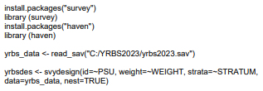
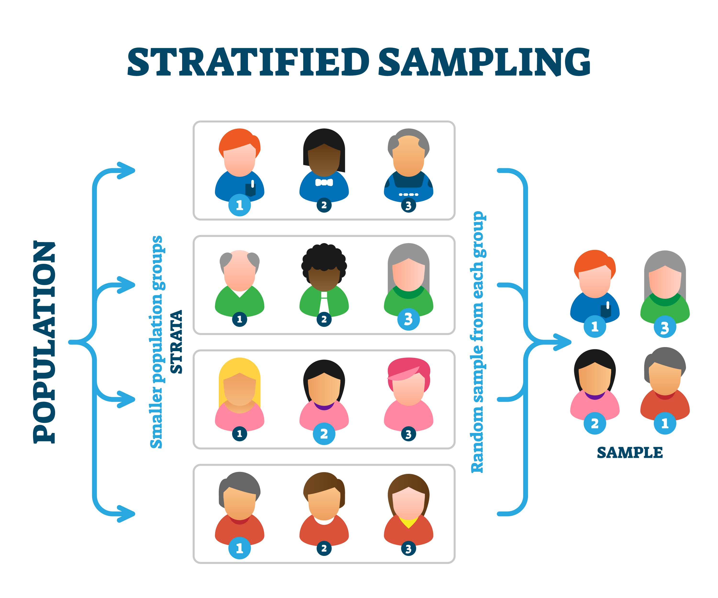
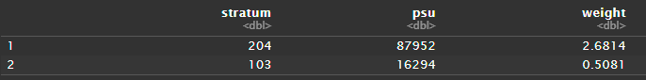
YRBS Sampling Methods
If you treat CDC data like a simple spreadsheet, your results will be wrong. Survey weighting is important.
Strata
Groups schools by racial/ethnic concentration and urbanicity.
Primary Sampling Unit (PSU)
Represents counties or chunks of very large counties.
Weight
Based on student’s race, sex, ethnicity, grade level.
Applied to each student to adjust for response rates and oversampling.
Notes:
Speaker notes:
YRBS oversamples rarer minority groups to ensure they are adequately represented in large enough sample sizes, and then adjust for the oversampling with weights.
In this example, the student weighted at .5 is overrepresented in the sample compared to true population data, and the student with 2.6 is underrepresented. The weights adjust the power of their responses in the survey so that their voices remain proportional to the population.
Stratum and PSU are used to ensure sub-sampling models select appropriately from each bucket, rather than truly randomly. Students in the same PSU will be expected to more more related – they have the same teachers, the same community, similar food. So for a good sample, proportional representation across PSUs is necessary to avoid collinearity. This can actually penalize overall sample size because a PSU of 50 students gets treated as a “hive mind”, resulting in higher P-Values. But with a survey of 20,000, that isn’t really an issue.

Slide 13
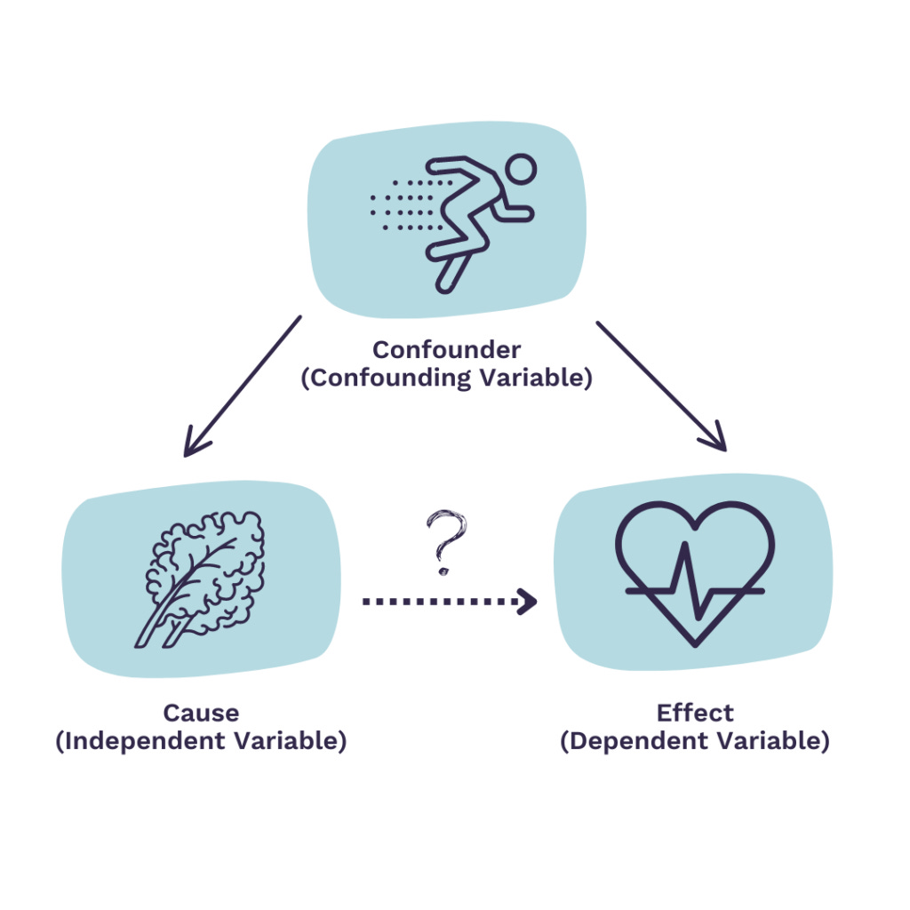
YRBS Sampling Methods
Non-response bias
The weights treat students who don’t participate differently from those who do.
The CDC tracks response rates at school, class, student levels.
If a particular demographic group has a low response rate, the weights of those in that group who did respond are increased.
This causes an adjustment to standard errors and prevalence rates that better represent the population.
Volunteer Bias
PSU Selection is random. Schools can not opt-in unless they are selected.
This avoids overrepresentation of well-managed or eager schools.
Controlling confounding variables by design
Does not completely eliminate them. We can not establish true causality.
Strata controls for geographic confounding, weights control for representative confounding, and common confounders like age, race, sex, grade, BMI, are collected to give researches the ability to check for confounding.
Notes:
Causality – Does social media cause the drinking, or does the drinking cause the social media? We can’t eliminate lurking variables like home stress or genetics.

Slide 14
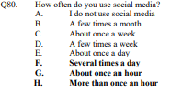
Exploratory Analysis
Notes:
Scroll through html file and show how parts of it were used. Explain the variable coding trend.

Slide 15
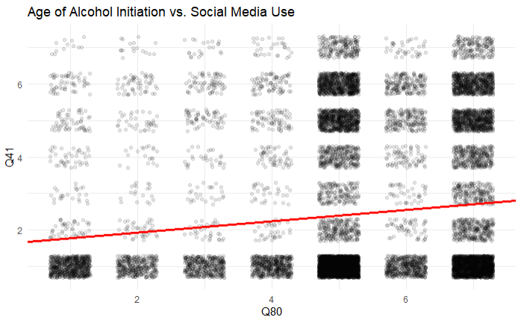
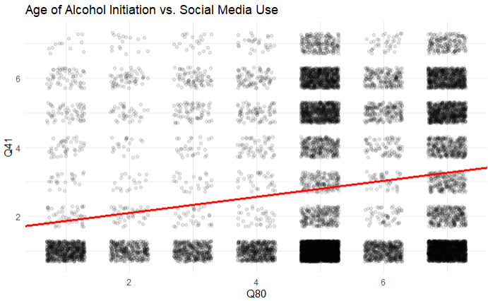
Research is Essential
Some of our steepest slopes were also steep for reasons other than legitimate increase in prevalence.
Researching the methodology behind each question is essential.
In this case, we had to flip the scale on this variable (Age of Alcohol Initiation) to get the intended results.
Notes:
Q41 comes out as the steepest slope of all variables to Q80. But because of what the question asks, the slope doesn’t really mean what it seems to mean. All it really shows in reality is that most teens start drinking when they’re older, because the order of the variables in the data set are “More is Higher”, in this case, “Older is Higher”, which is not the correlation we are looking for. We are looking for “Worse is Higher”, and when this question gets recoded, the correlation remains, but does decrease.

Slide 16
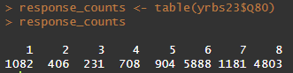
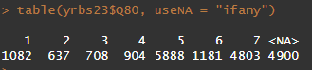
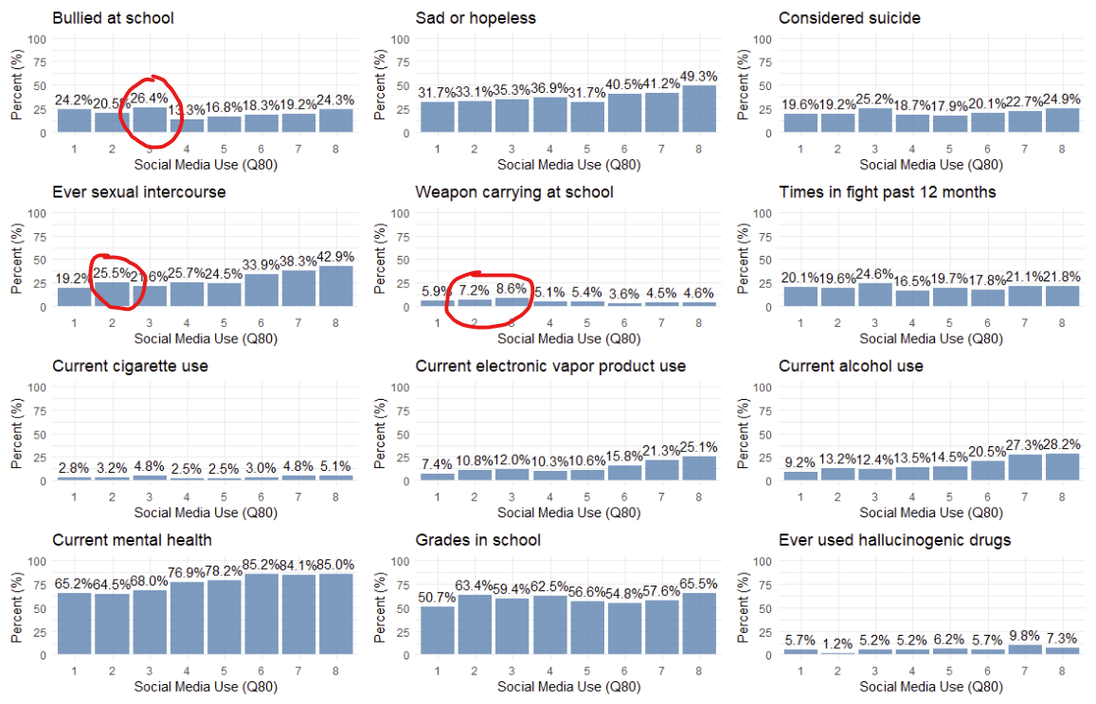
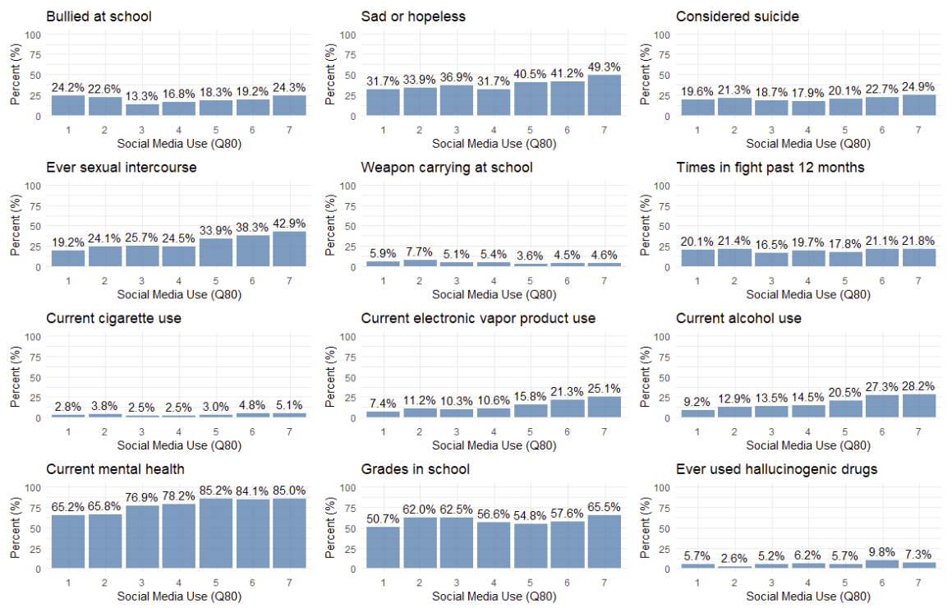
Grouping for Higher Resolution

Slide 17
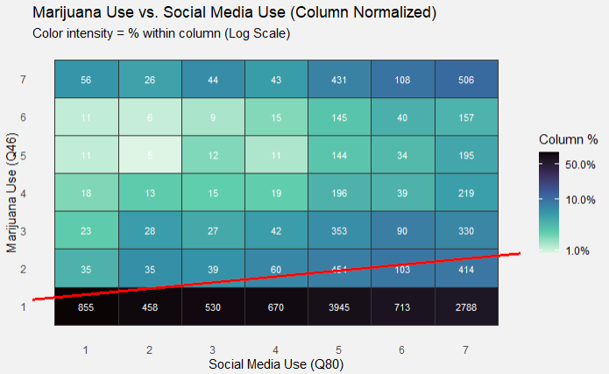
Marijuana Use – The Most Correlated
Hypothesis Test:
The regression yielded a slope coefficient β of .157
"The 95% Confidence Interval for this effect is .127 - .186. We are 95% confident this range captures the true population slope.
Because this interval does not contain zero, the result is statistically significant.
The calculated p-value was 1.41071e-15 (p < .05). Therefore, we reject the null hypothesis.
Increased Social Media use does effect increased Marijuana use for teens.
H0: Prevalence of Marijuana use is consistent across social media use frequencies (β = 0).
HA: Prevalence of Marijuana use changes in relationship with social media use frequency (β ≠ 0).
Notes:
After controlling and upside-down questions, and non-scaled questions, this is the most correlated. Walk through the steps, while they do appear on the next slides anyway, the whole hypothesis test does not need to be reiterated over and over – but here it does need to be stepped through to demonstrate understanding.

Slide 18
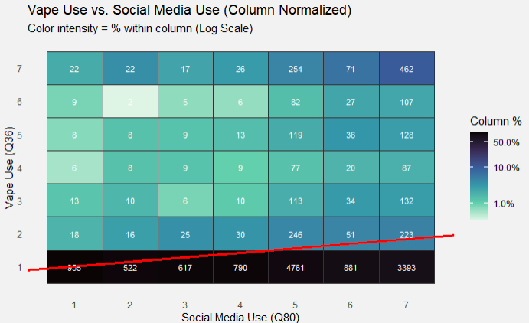
Vape Use
Hypothesis Test:
The regression yielded a slope coefficient β of .137
"The 95% Confidence Interval for this effect is .105 - .168. We are 95% confident this range captures the true population slope.
Because this interval does not contain zero, the result is statistically significant.
The calculated p-value was 2.759901e-12 (p < .05). Therefore, we reject the null hypothesis.
Increased Social Media use does have an effect on increased vape use for teens.
H0: Prevalence of vape use is consistent across social media use frequencies (β = 0).
HA: Prevalence of vape use changes in relationship with social media use frequency (β ≠ 0).
Notes:
Breeze through, ten seconds. It’s good data, but it follows the same trend as established and does not need to be beat to death.

Slide 19
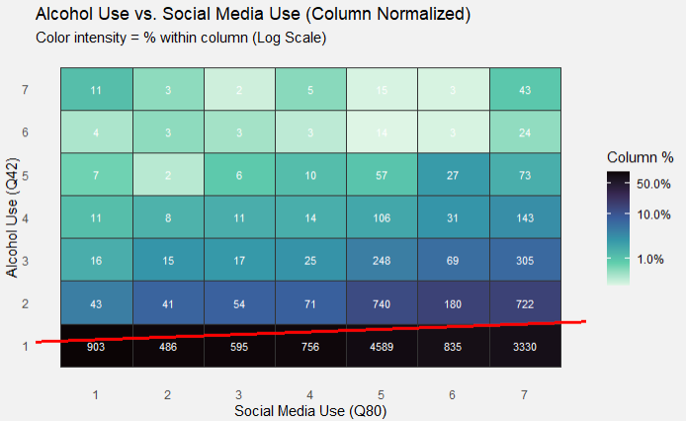
Alcohol Use
Hypothesis Test:
The regression yielded a slope coefficient β of .062
"The 95% Confidence Interval for this effect is .036 - .088. We are 95% confident this range captures the true population slope.
Because this interval does not contain zero, the result is statistically significant.
The calculated p-value was 0.0000124 (p < .05). Therefore, we reject the null hypothesis.
Increased Social Media use does have an effect on increased Alcohol use for teens.
H0: Prevalence of alcohol use is consistent across social media use frequencies (β = 0).
HA: Prevalence of alcohol use changes in relationship with social media use frequency (β ≠ 0).
Notes:
Breeze through, ten seconds. It’s good data, but it follows the same trend as established and does not need to be beat to death. There are fewer daily users, bringing the slope down, but the trend is still clear.

Slide 20
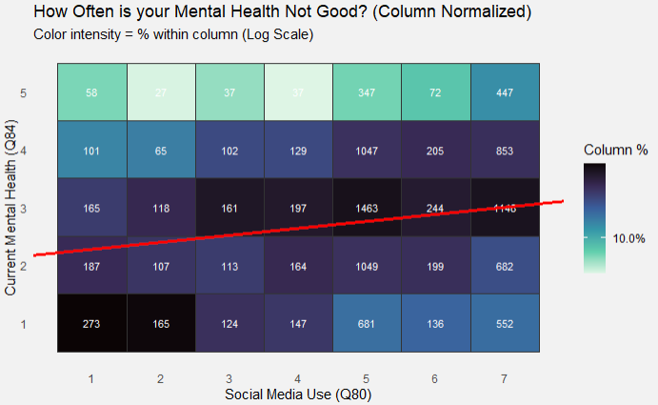
Current Mental Health
Hypothesis Test:
The regression yielded a slope coefficient β of .121
"The 95% Confidence Interval for this effect is .071 - .171. We are 95% confident this range captures the true population slope.
Because this interval does not contain zero, the result is statistically significant.
The calculated p-value was 9.974209e-06 (p < .05). Therefore, we reject the null hypothesis.
Increased Social Media use does have an effect on mental health for teens.
H0: Mental Health is consistent across social media use frequencies (β = 0).
HA: Mental Health changes in relationship with social media use frequency (β ≠ 0).
Notes:
Breeze through, ten seconds. It’s good data, but it follows the same trend as established and does not need to be beat to death. The scale sits more in the middle, there are fewer overall students reporting “Never”, most fall in “Rarely” to “Sometimes”, but the proportion of “Most of the Time” and “Always” for higher Social Media Use, drags the slope up.

Slide 21
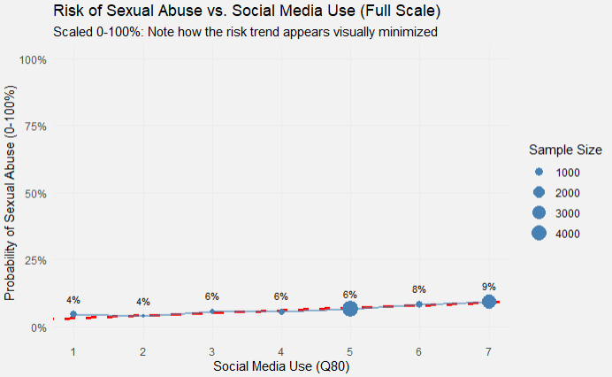
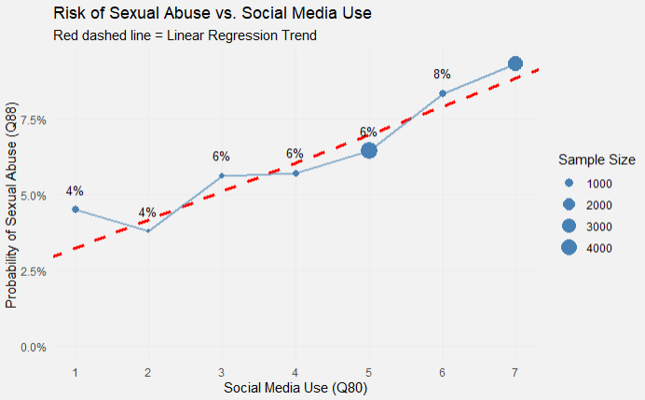
Why linear regression isn’t always the most obvious indicator
Likelihood of Reporting Sexual Abuse
H0: Prevalence of Sexual Abuse is consistent across social media use frequencies (β = 0).
HA: Prevalence of Sexual Abuse changes in relationship with social media use frequency (β ≠ 0).
Hypothesis Test:
The regression yielded a slope coefficient β of .00937. This indicates that for every unit increase in social media frequency, the probability of reporting sexual abuse increases by .934%, almost 1%.
"The 95% Confidence Interval for this effect is .000573 - .01300. We are 95% confident this range captures the true population slope.
Because this interval does not contain zero, the result is statistically significant.
The calculated p-value was 3.283548e-06 (p < .05). Therefore, we reject the null hypothesis.
Increased Social Media use does have an effect on increased sexual abuse for teens.
Notes:
Multitasking on this slide. Showing how scale affects the report, how the importance of the variable matters, and demonstrating understanding of how a regression on a binary variable changes the meaning of the slope from a unit increase to a % chance increase. Don’t forget to say that, it’s important.

Slide 22
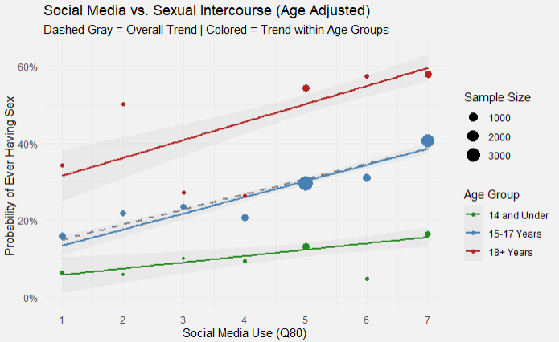
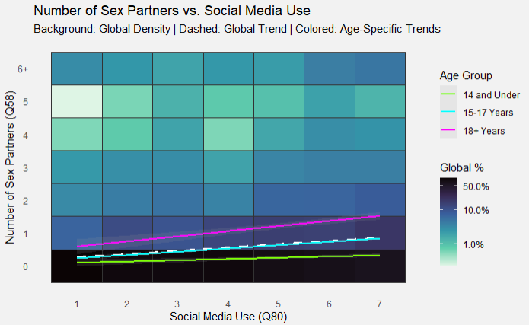
Interacting Variable
Age is an Accelerator, Not Just a Confounder
It’s not just "getting older": If age were the only factor, the lines would be flat. They aren't.
The Interaction Effect: Social Media predicts sexual activity for all age groups.
The difference is intensity: For older teens (15+), Social Media acts as a catalyst, creating a much steeper rise in risk compared to younger teens.

Slide 23
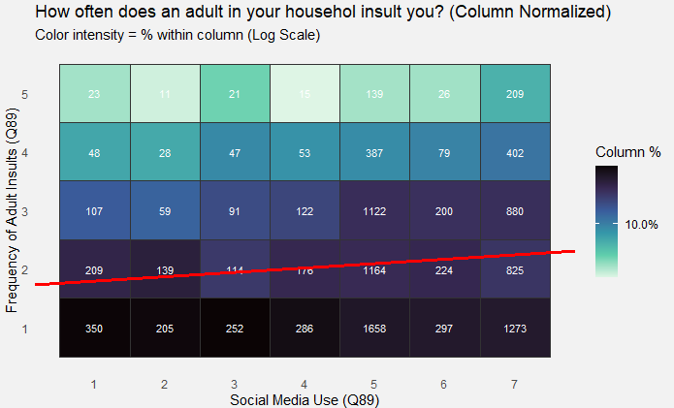
Lurking Variables
It seems likely that students who overuse Social Media wouldn’t necessarily have consistently more cruel parents. Possible Lurking Variables
Escapism - Students who feel unsafe at home use Social Media more.
Poor Parenting - Poorer parental control over screen time may coinciding with absent or cruel parents.
Negative Filter - Social Media addicts may be more sensitive to otherwise normal interaction.
Vicious Cycle - Overuse of Social Media could prompt parents to be more critical of their children.

Slide 24

Summary
Social Media has an effect on some behaviors, but not all.
We did not show every relationship we found, just some of the more interesting or alarming ones.
Texting and driving, gender (males use more), potato and carrot eating, sports, oral health care, grades in school.
There are also relationships that are extremely slight or insignificant.
Bringing weapons to school, hours of sleep, drinking water, feeling safe at school, fighting.

